Slide 1
AGRO SHINE
A smart application for Precision Agriculture

Slide 2
TABLE OF CONTENTS
01
02
INTRODUCTION
OVERVIEW
03
04
WORKING
APPLICATION
Application for analyzing agricultural parameters
Provides a deeper insight into water requirement
Examines temperature, soil moisture, humidity, resistance etc.
Based on the given area of land, suggests accurate irrigation methods.

Slide 3
INTRODUCTION
A smart App for precision agriculture to generate irrigation schedule recommendations based on real-time weather and short-term forecasted data to better meet the plant water needs of a given period

Slide 4
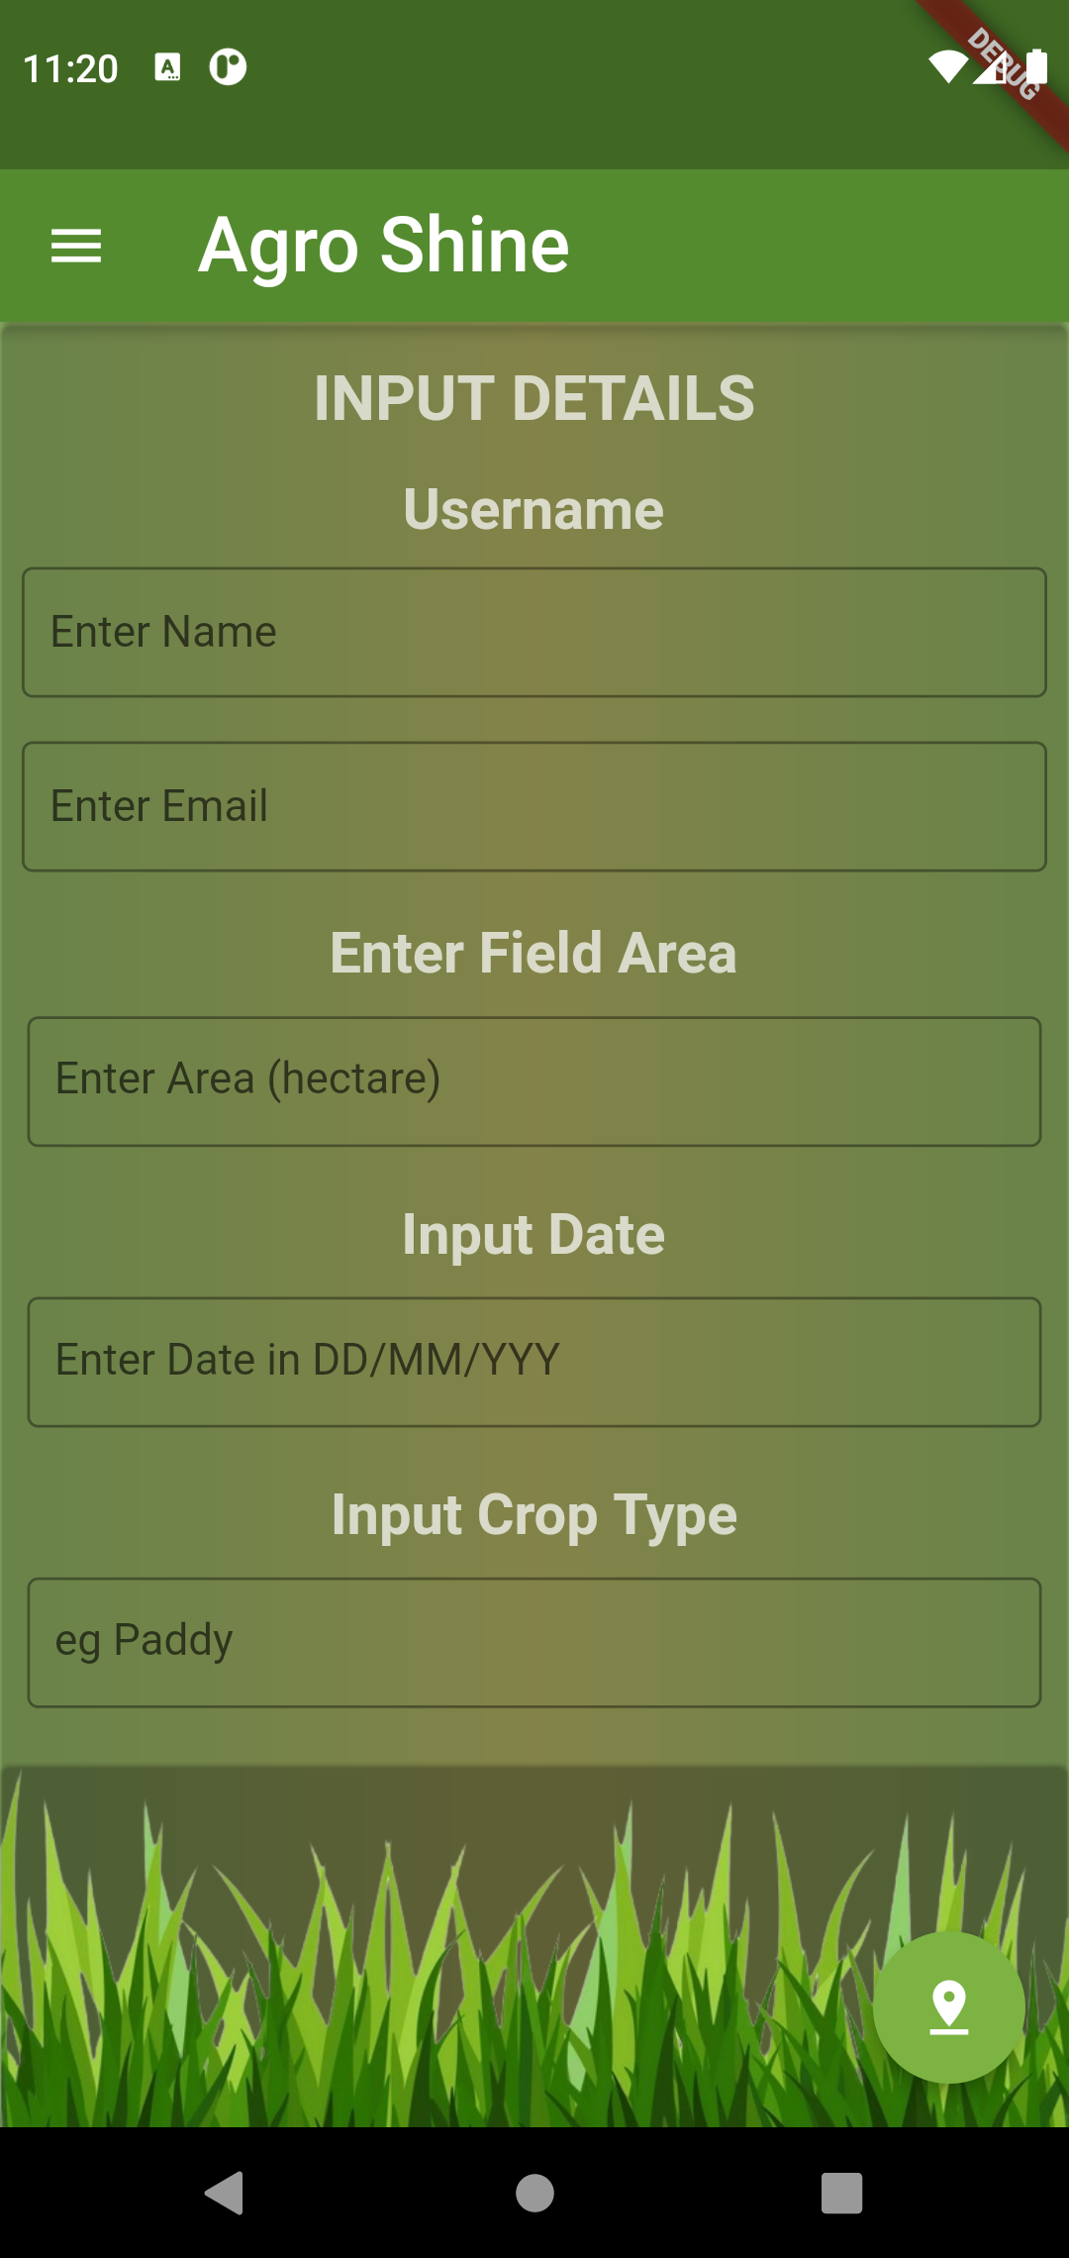
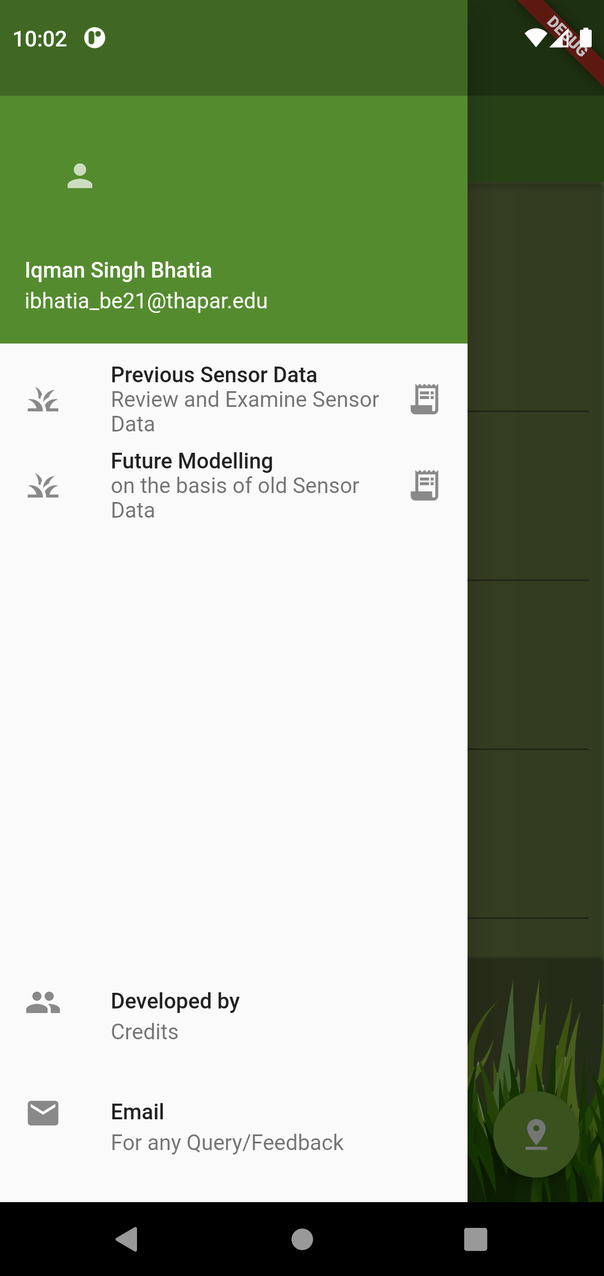

MOBILE APPLICATION
Currently in progress

Slide 5
DEMO

